Slide 1
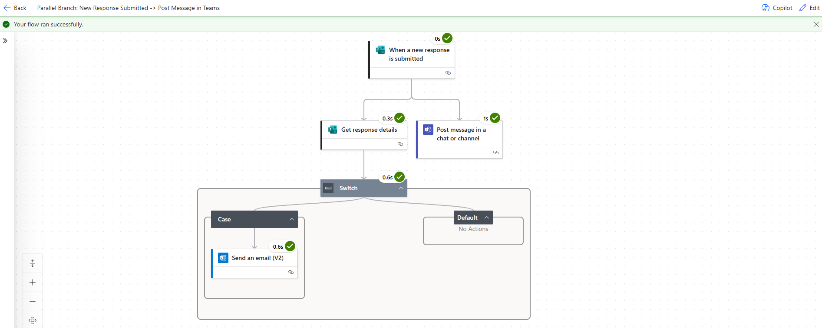
Parallel Branch - New Response Submitted in Forms → Post Message in Teams/Send Email

